Slide 1

Source: Campbell Junior High School
Notes:
Image credit: Campbell Junior High School - https://teach.clarkschools.net/Middle/Campbell/index.php/rdc-literacy-focus/

Slide 2

Building Literacy
K-3 English Language Arts Education and Data Science
by Sean Davern
Notes:
Today I'm here to
Bringing you a story about
building literacy
in specific in the area of ...
thru my own DS literacy building.
18 s

Slide 3
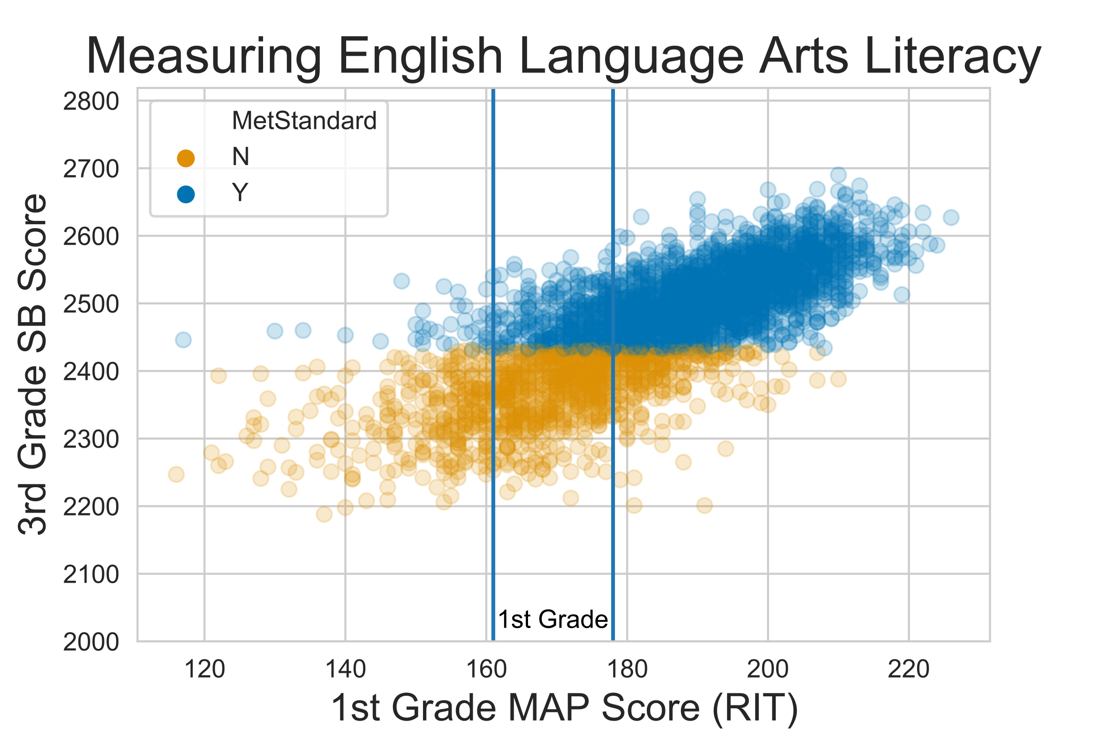
The Challenge(s)
Notes:
In elementary school testing is given to measure academic progress.
The measure of academic progress or MAP is in Rash Unit, or RIT.
As an example, students entering 1st grade...
161 to 178
By 3rd grade the state mandates students take the Smarter Balanced Assessment, scores > 2432 are meeting standards
My mission, as I chose to accept it...
MAP = Measure of Academic Progress
MAP score units: RIT (Rasch Unit)
Smarter Balance score are unitless. 3rd Grade Levels:
1: < 2381
2: 2381-2431
3: 2432-2489 Met Standard
4: > 2489

Slide 4

Serving K-3 Elementary Kids
Notes:
Among the MANY people and organizations working to get kids to meet 3rd grade reading standards is

Slide 5
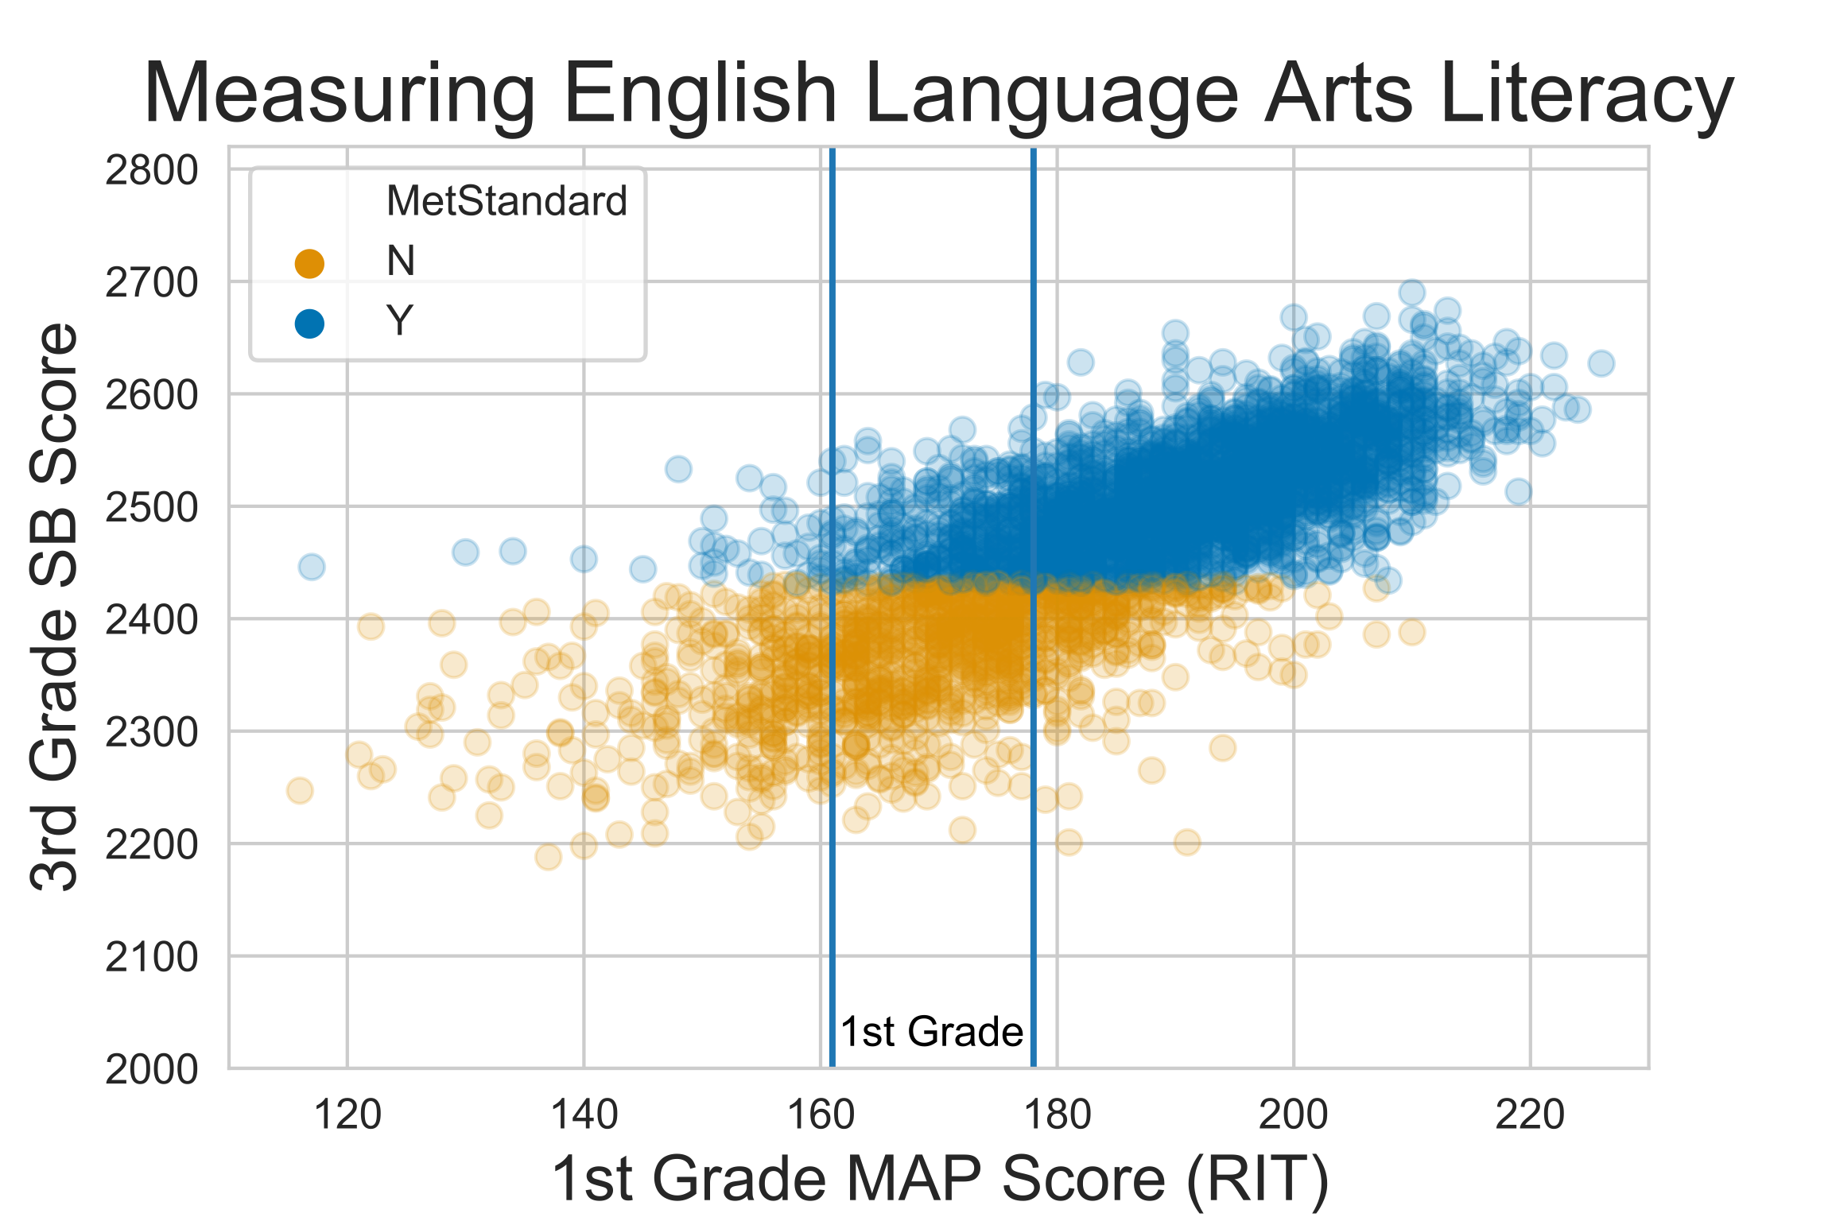
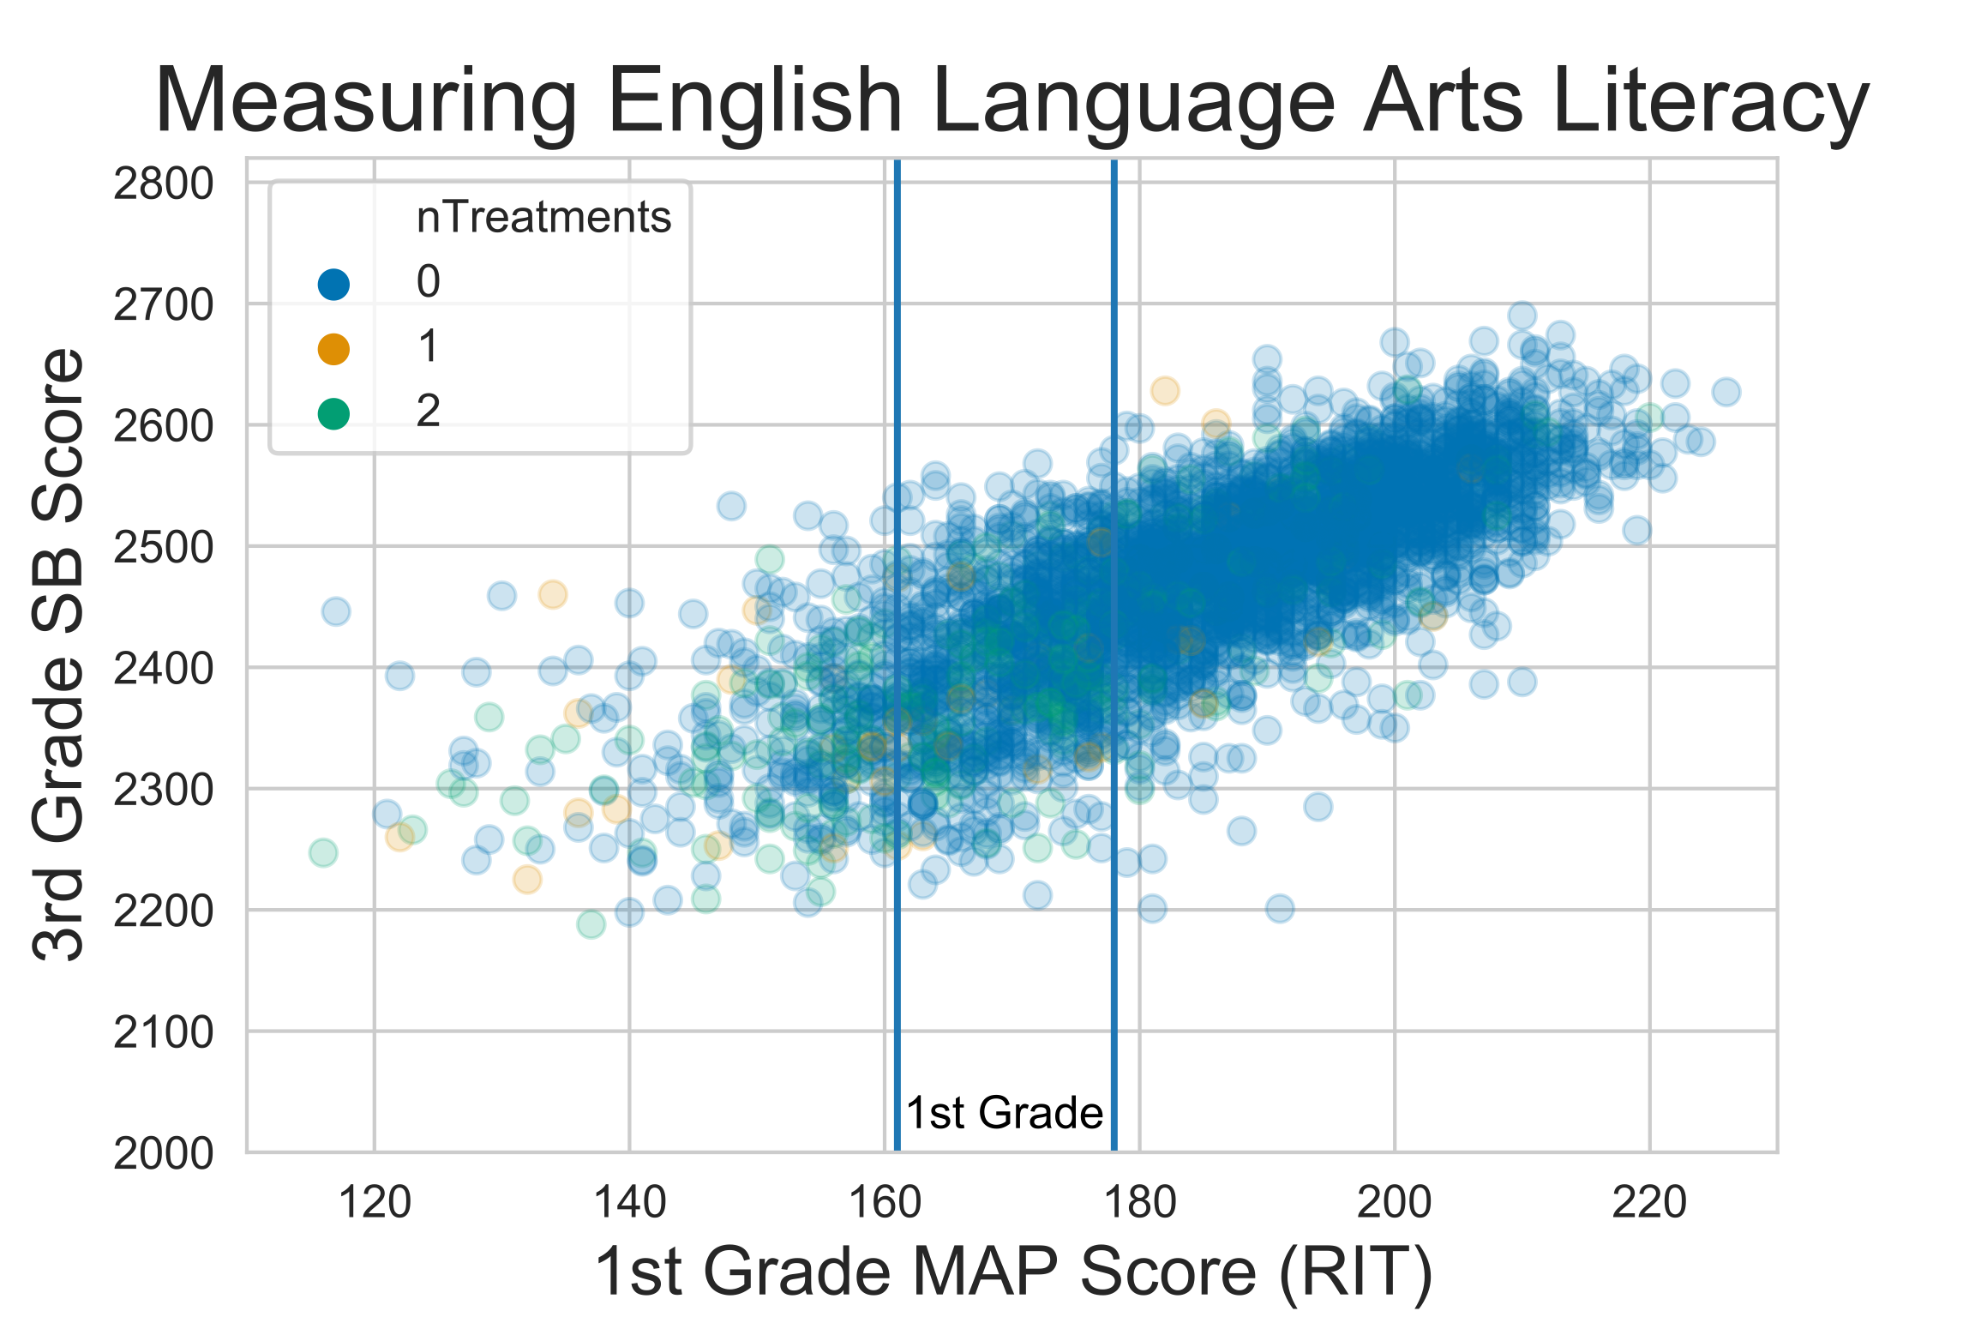
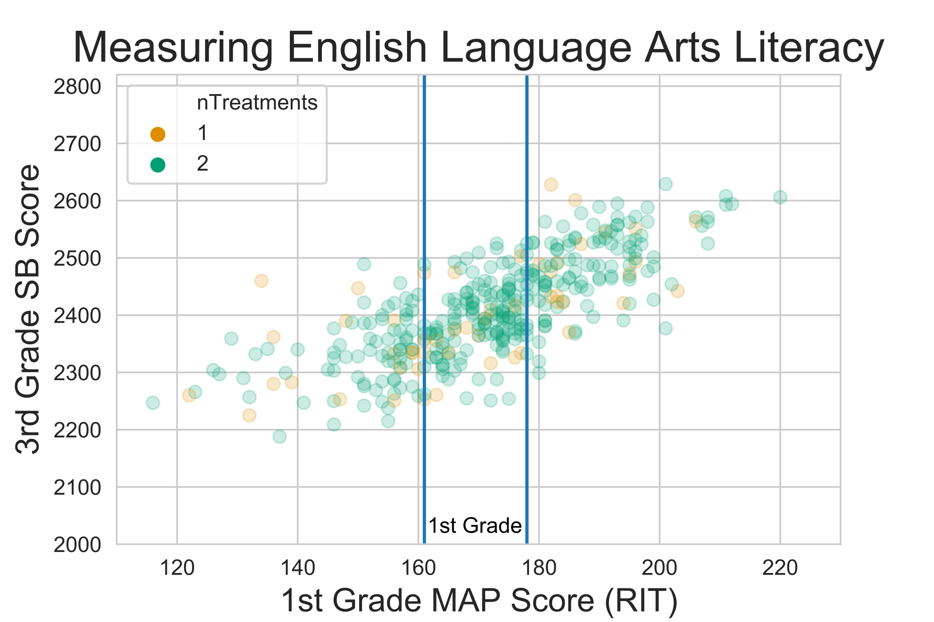
The Challenge(s)
Notes:
As you can see, the challenge is

Slide 6
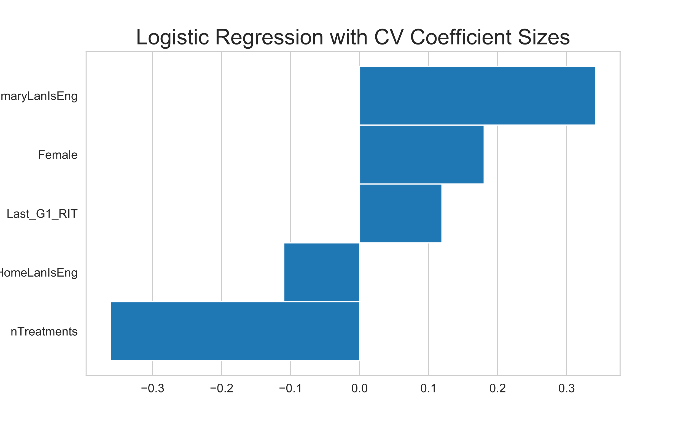
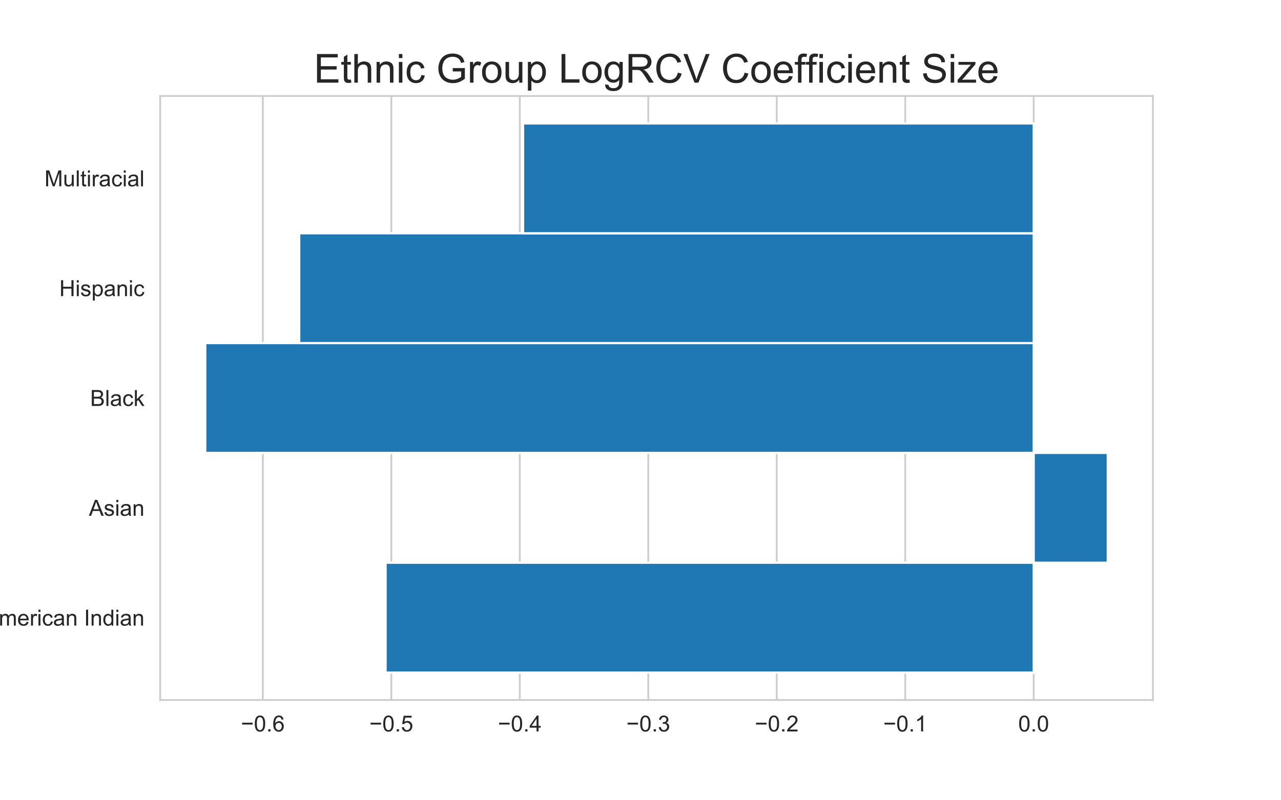
Model Results
 | precision | recall | f1-score | support
N | 0.76 | 0.69 | 0.72 | 219
Y | 0.87 | 0.90 | 0.88 | 492
accuracy |  |  | 0.84 | 711
macro avg | 0.81 | 0.80 | 0.80 | 711
weighted avg | 0.83 | 0.84 | 0.83 | 711
Notes:
The application of logistic regression with cross validation gave
precision is the ability of the classifier not to label as positive a sample that is negative
recall is the ability of the classifier to find all the positive samples
F-measure (F1 measures) can be interpreted as a weighted harmonic mean of the precision and recall

Slide 7
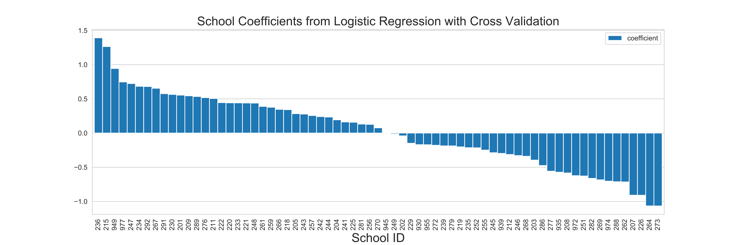
Model Results
Notes:
Done by 3:15

Slide 8
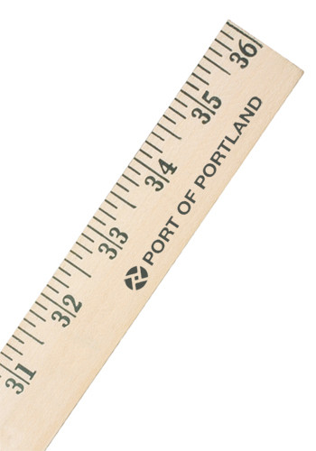
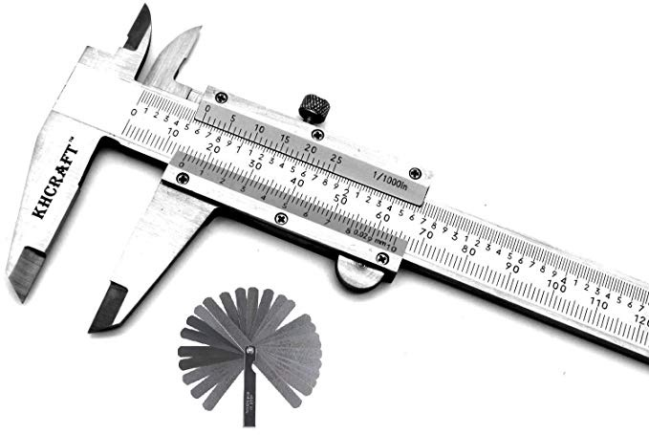
Conclusions & Future Work
Model growth rather than if met standard
Consultation with Page Ahead
Expert advice
K Data + 2019 Smarter Balance results
Notes:
After the work completed so far, I've come to the following conclusions...
score vs categories

Slide 9


Slide 10
Appendix

Slide 11
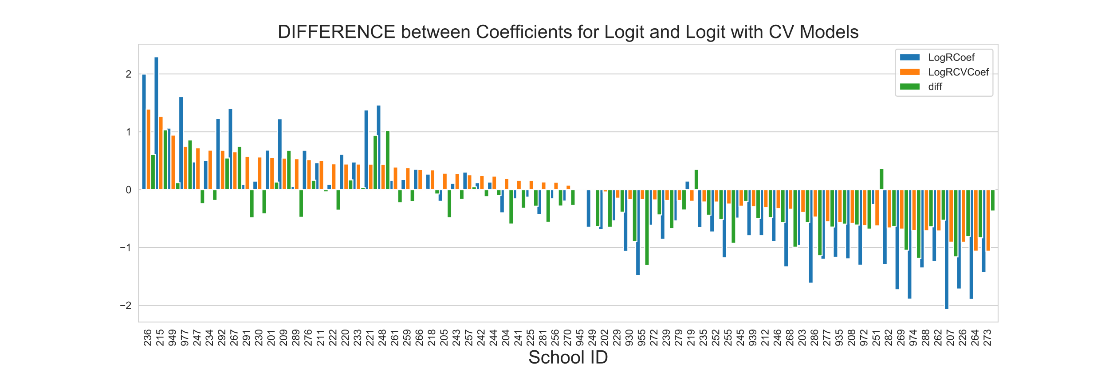
Model Results

Slide 12
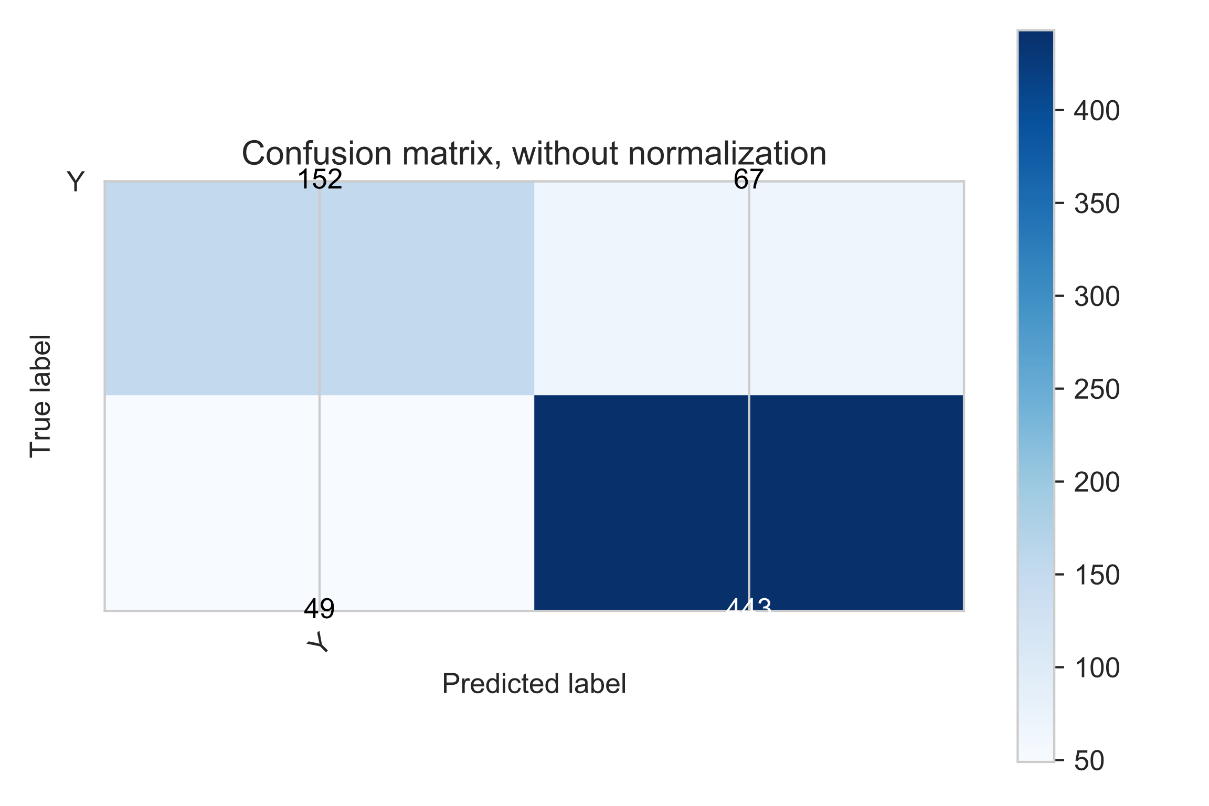
Confusion Matrix

Slide 13
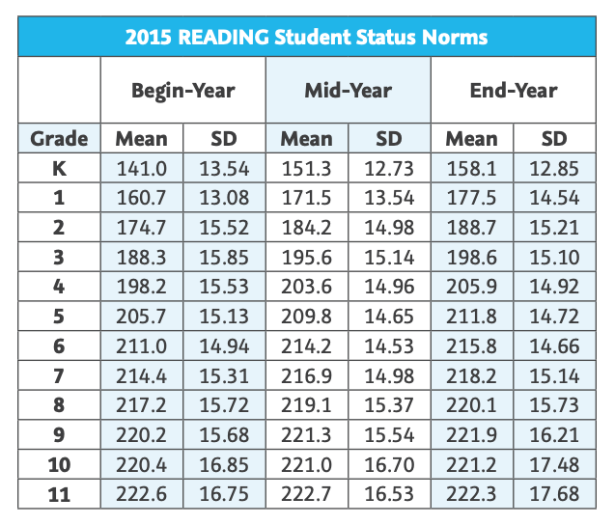
Reading Score Norms
Notes:
Source: https://www.kusd.edu/lance/houses/documents/2015-MAP-Normative-Data-AUG15.pdf

